Slide 1
Web service

Slide 2
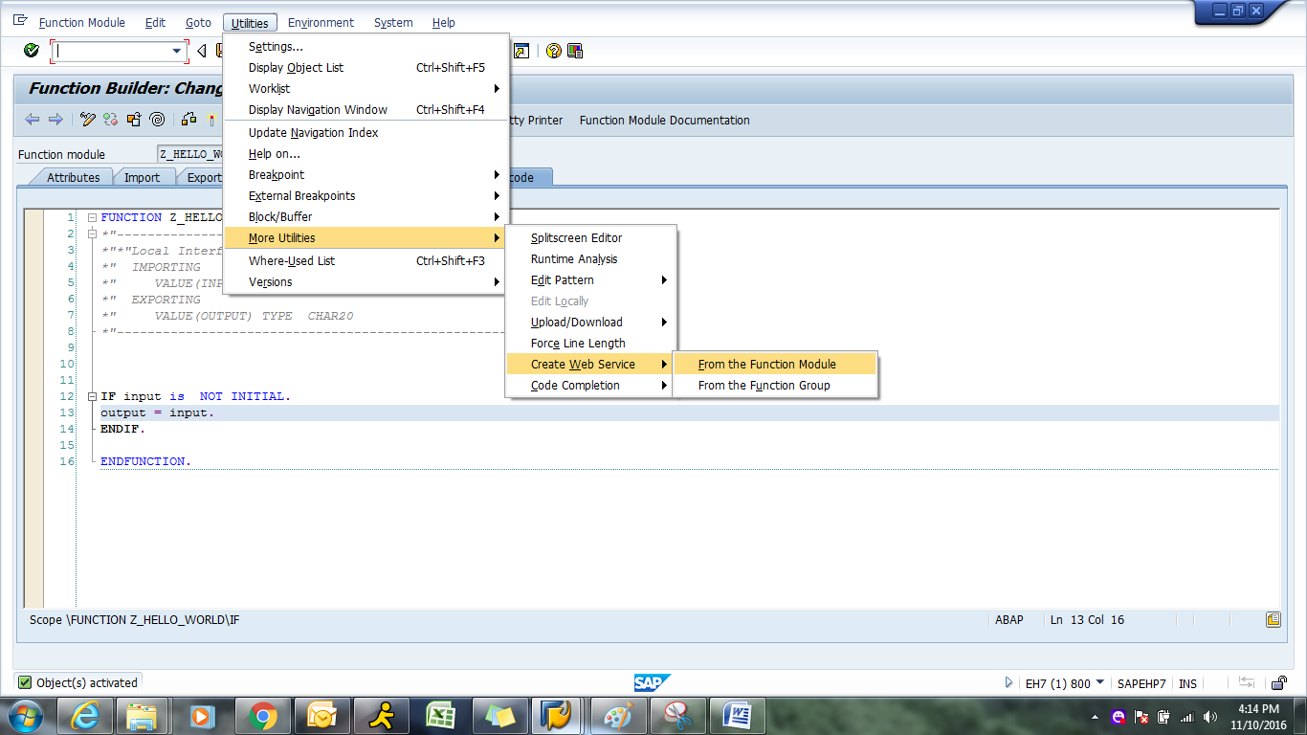
After creating FM , we need to create web service. Below are steps to create web services
.

Slide 3
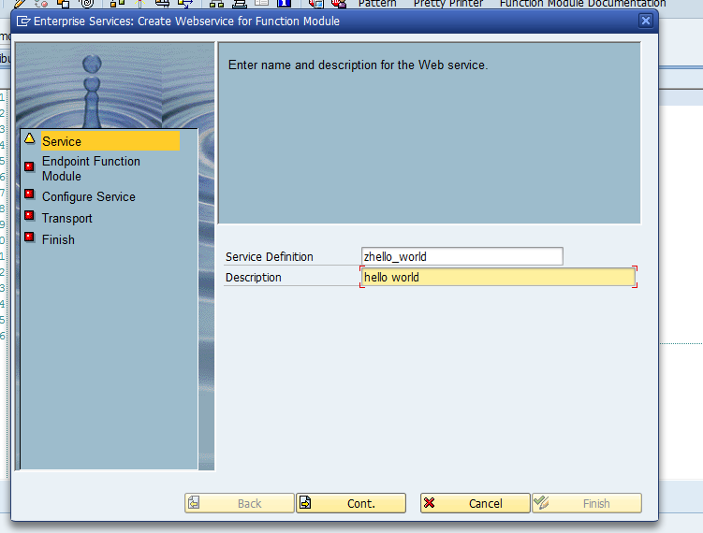
Click on Continue.

Slide 4
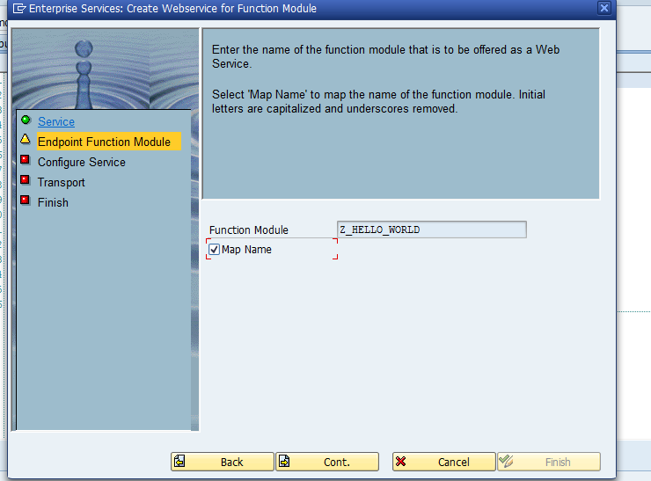
Click on Continue.
Notes:
Click on Continue

Slide 5
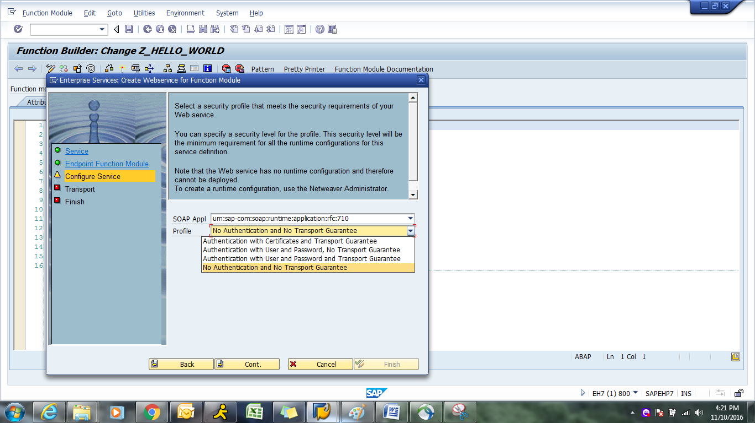

Slide 6
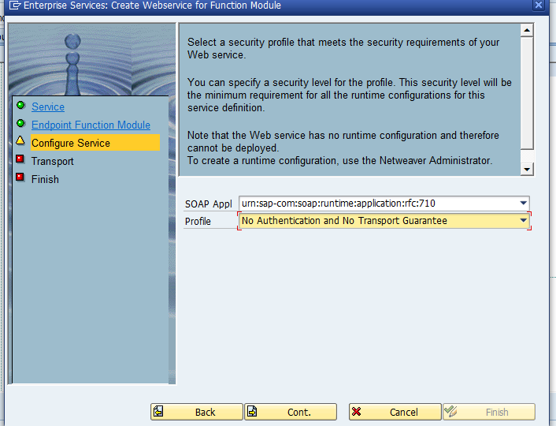
Click on continue.
Notes:
Click on continue.

Slide 7
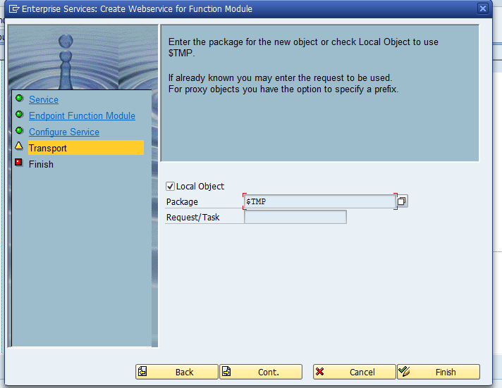
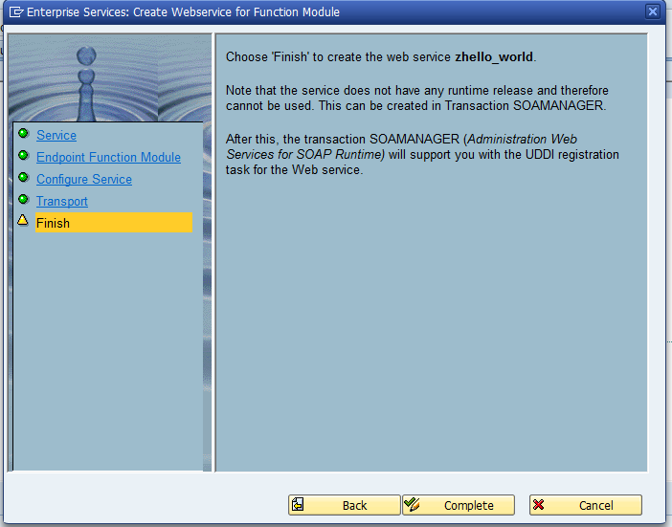
Click on complete.
Notes:
Click on complete.

Slide 8
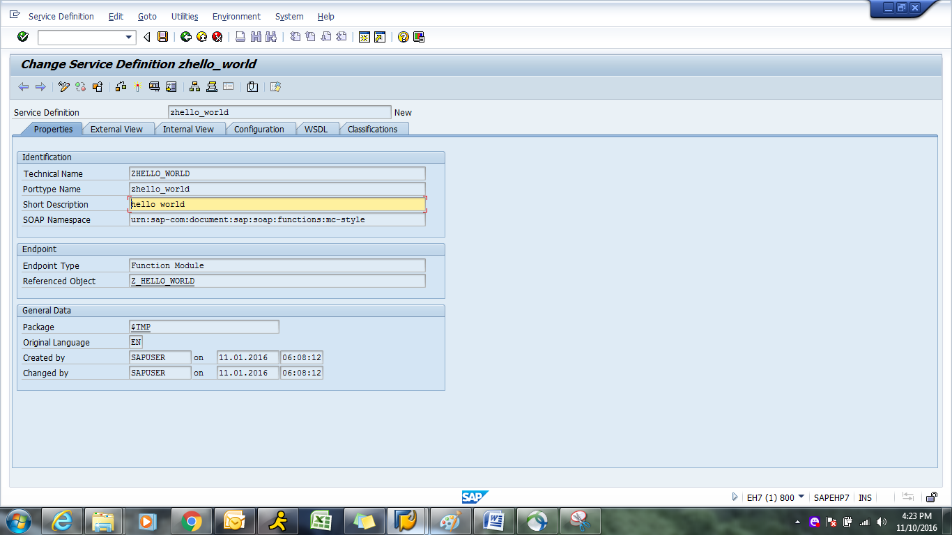
Activate it .
After creating web service we need to create binding for it.
Notes:
Activate it .
After creating web service we need to create binding for it.

Slide 9
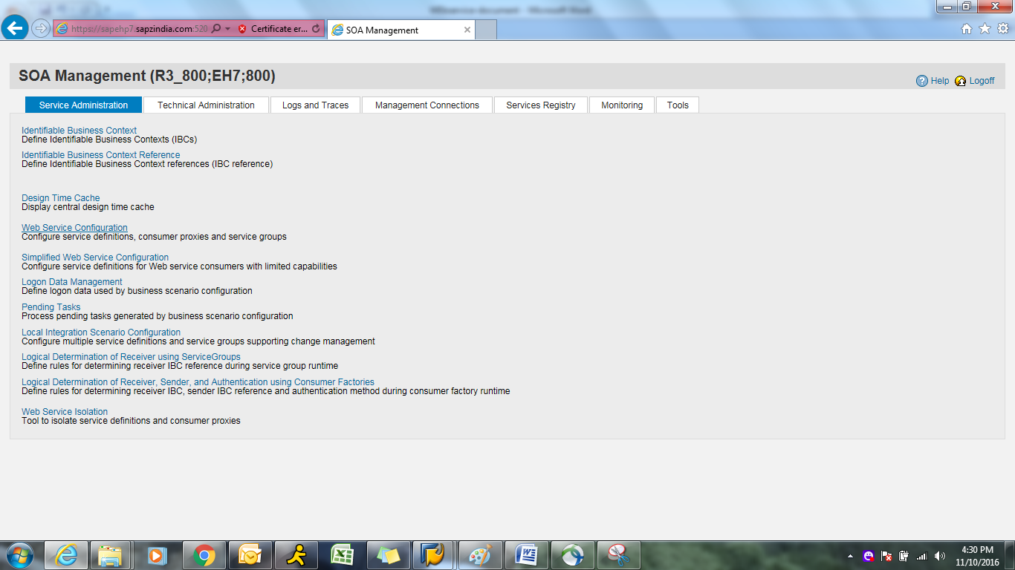
Go to SOAMANAGER t-code to create binding for web service.
Notes:
Go to SOAMANAGER t-code to create binding for web service.

Slide 10
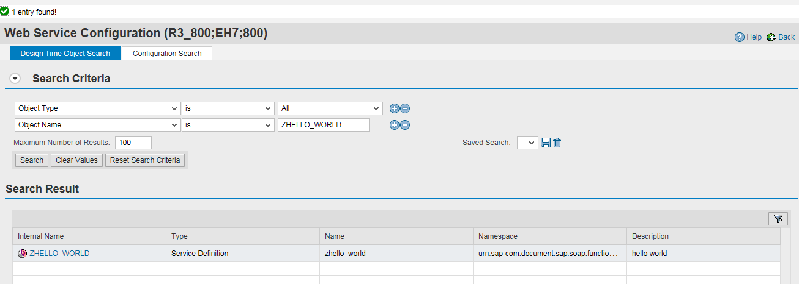
Click on web service configuration
Notes:
Click on web service configuration

Slide 11
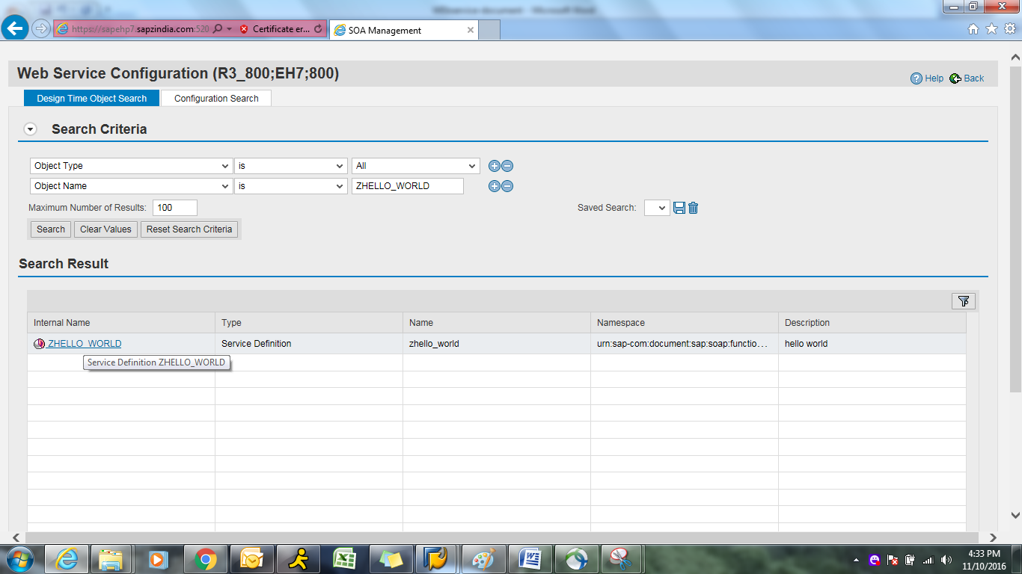
Click on internal name .
Notes:
Click on internal name

Slide 12
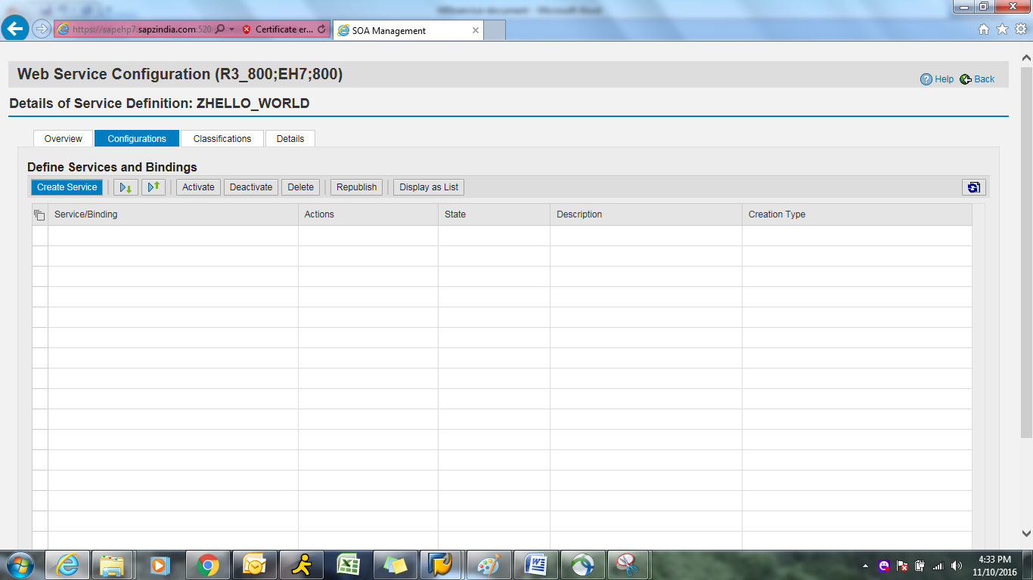
Create binding as below
Notes:
Create binding as below.

Slide 13
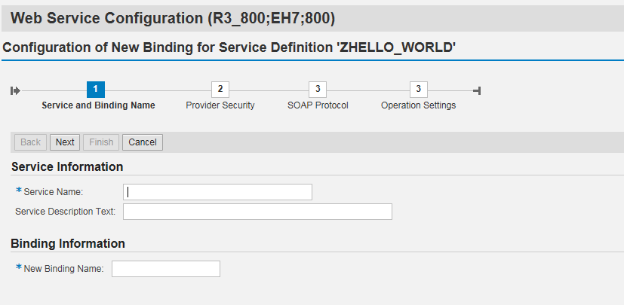

Slide 14
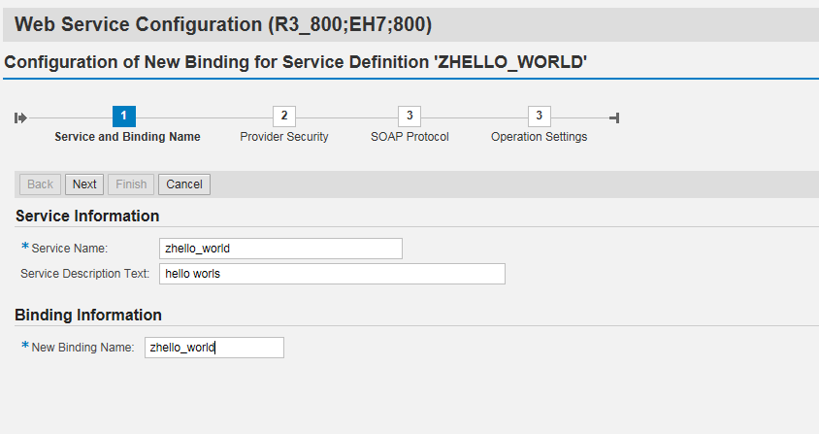
Create service name as below
Notes:
Create service name as below

Slide 15
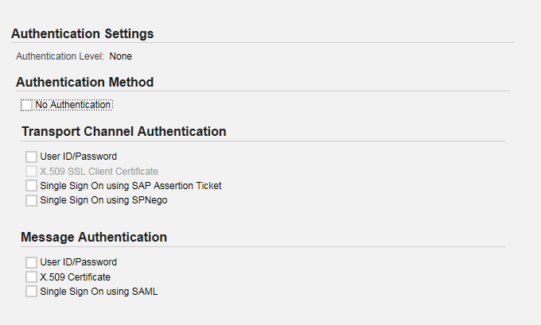
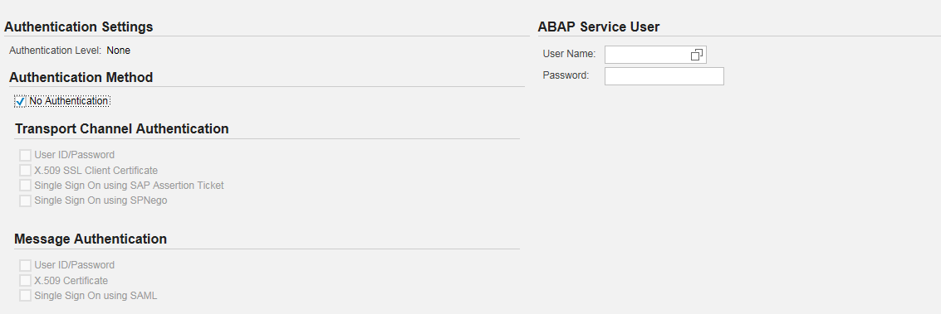
Click on NEXT.
Select NO Authentication box to provide generic user id and password.
Notes:
Click on NEXT.
Select NO Authentication box to provide generic user id and password.

Slide 16
Provide user name and password
Notes:
Provide user name and password

Slide 17
Click on next ,and finish it. After finish button below screen will appear .
Notes:
Click on next ,and finish it. After finish button below screen will appear .

Slide 18
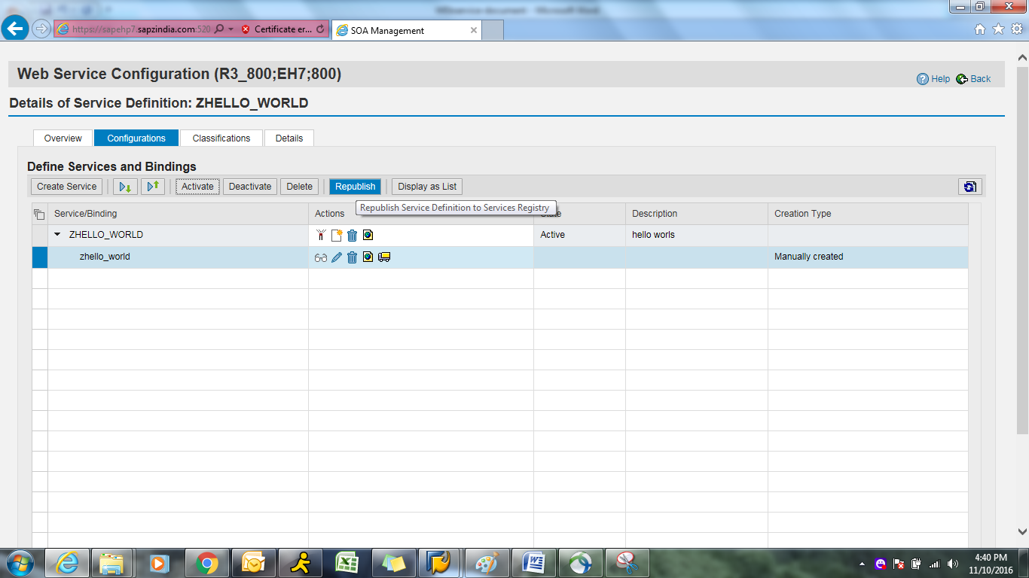
Click on Republish button as below.
Notes:
Click on Republish button as below

Slide 19
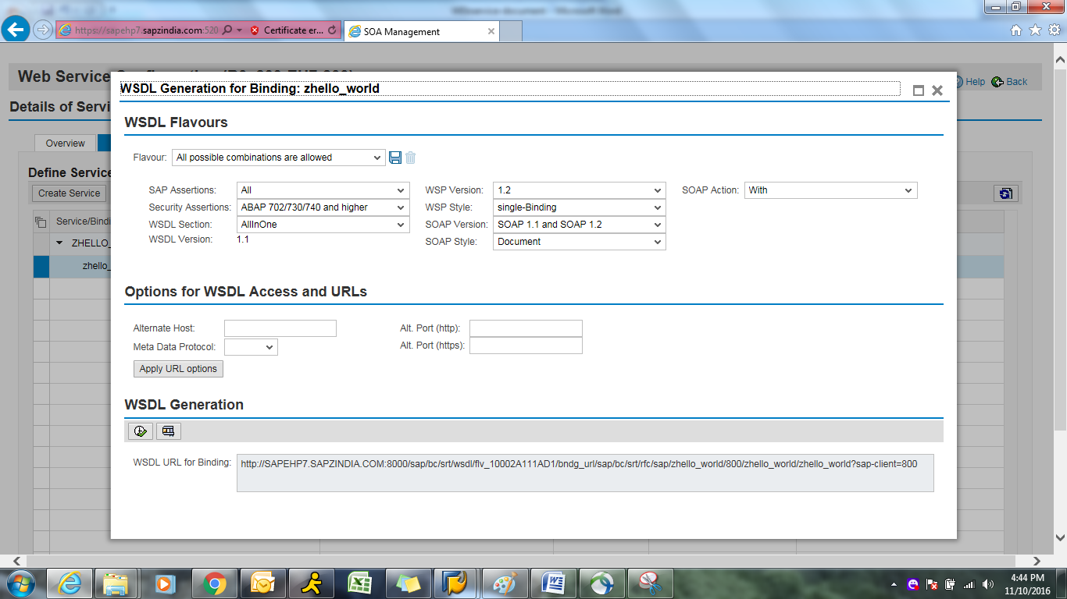
Click on URL icon to view below screen.
Notes:
Click on URL icon to view below screen.

Slide 20
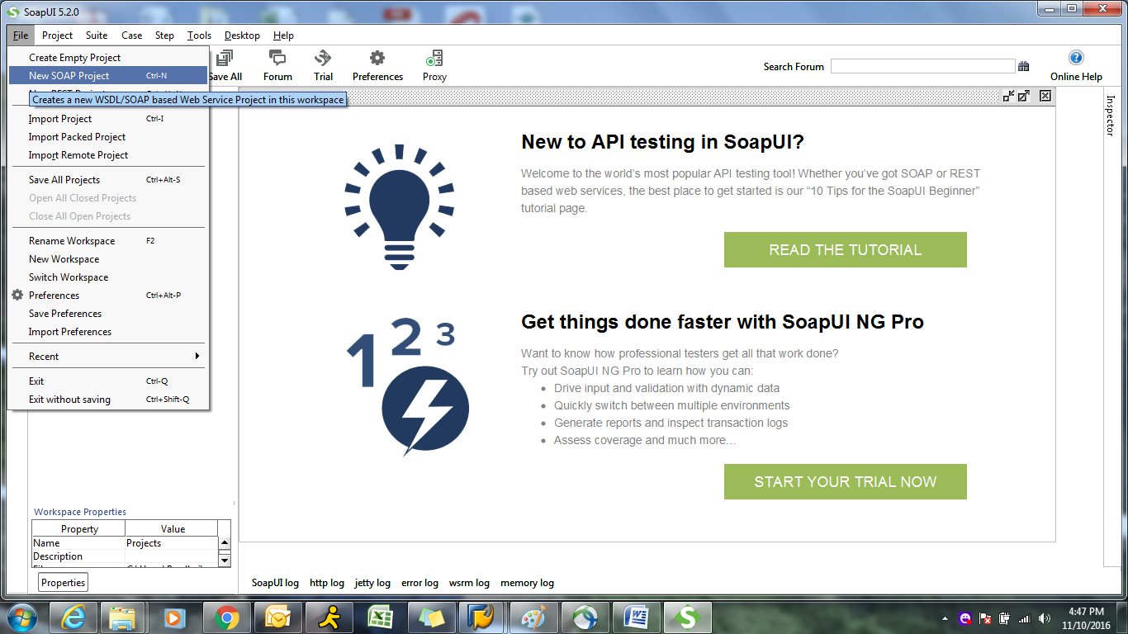
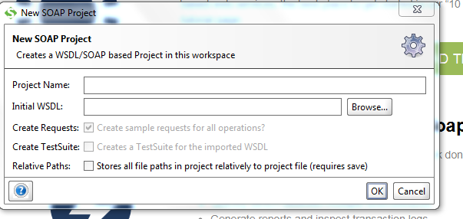
TO test above URL we need to go to SOAP UI .
Notes:
TO test above URL we need to go to SOAP UI .

Slide 21
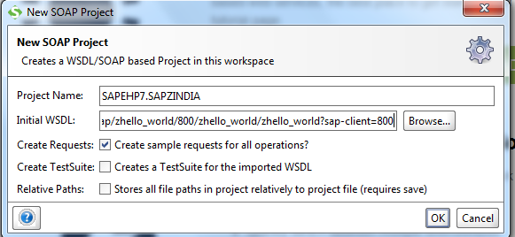
Give URL in WSDL box as below.
Click on OK.
Notes:
Give URL in WSDL box as below.
Click on OK.

Slide 22
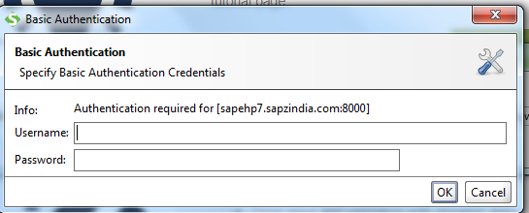
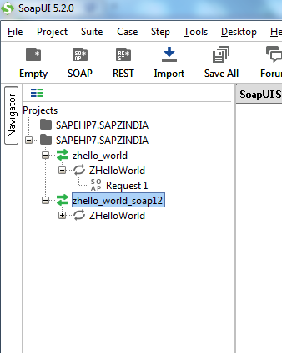
If it ask for credentials give user Id and password.
Notes:
If it ask for credentials give user Id and password

Slide 23
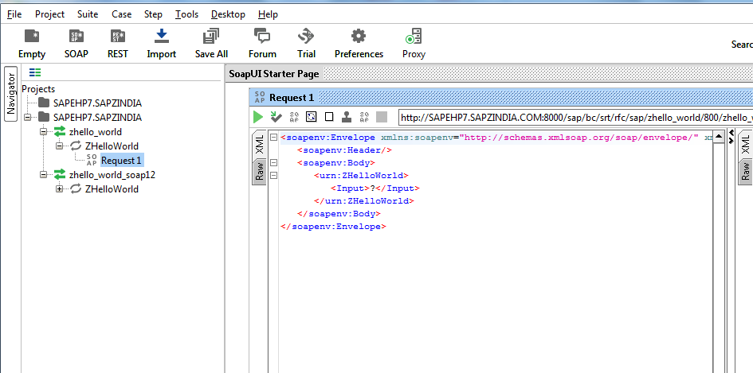
Click on Request 1 to give input for Function module .

Slide 24
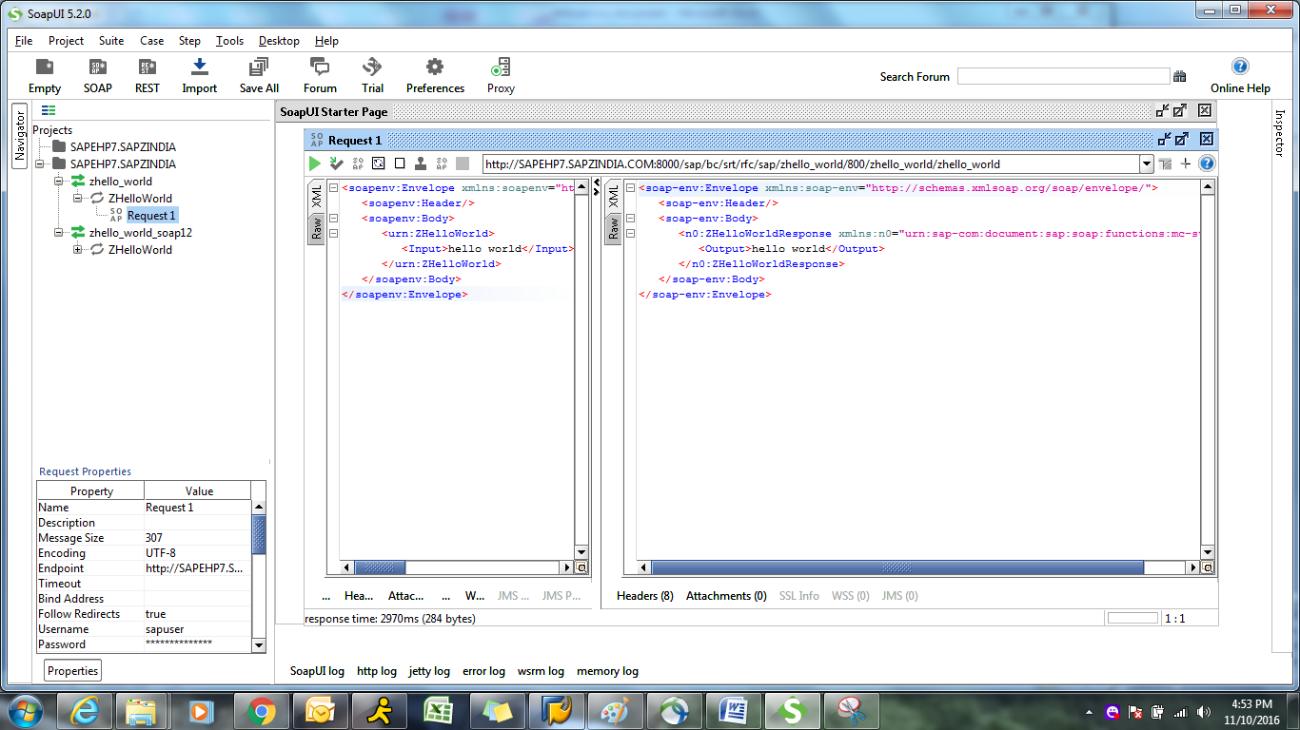
NOTE: In above screen we need to give user id and password in Properties TAB (left side as shown in screen)
Once we click on green button to execute below output will appear.
Notes:
NOTE: In above screen we need to give user id and password in Properties TAB (left side as shown in screen)
Once we click on green button to execute below output will appear.

