Slide 1
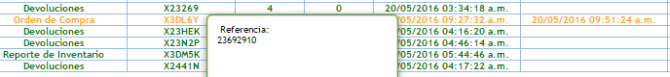
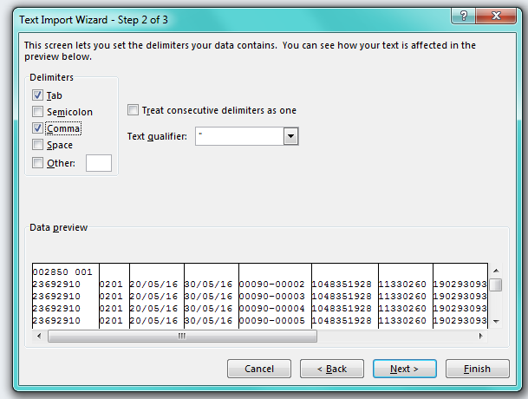
ASN LIVERPOOL
Download the .INF file from Levicom’s website from the purchase order that an ASN is require
2. Open the .INF file and give format

Slide 2
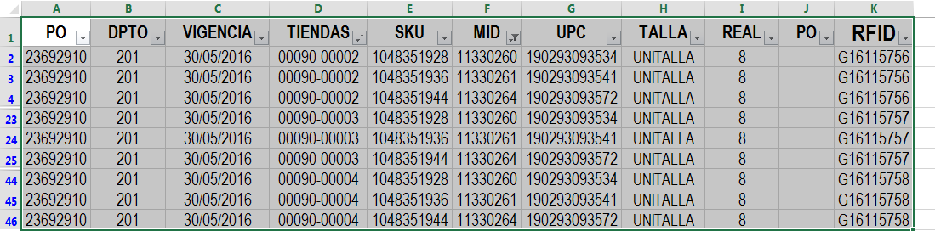
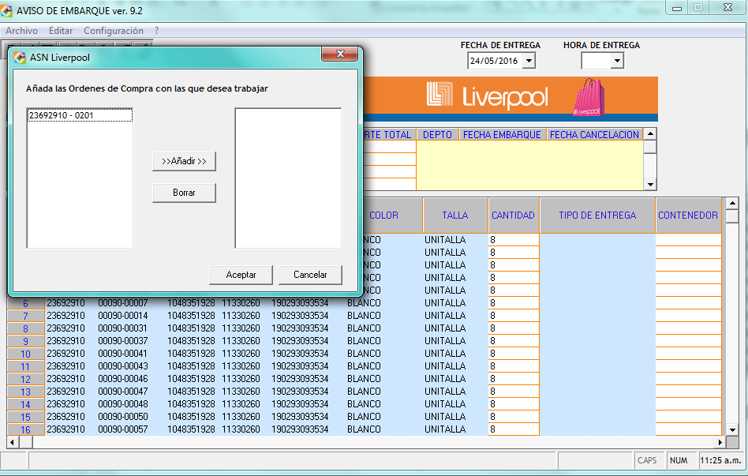
3. Select the useful information and assing an RFID Tag (Liverpool’s container), in this part of the process and ajustment is need it in the purchase order for the deliveries, if need it because sometimes the total of the pieces doesn’t match the total
Note: J Column only need to be fill is we have difference on the total. This column is not need it on the ASN. RFID Tag is assing for the total of pieces and maximum of files by everybox.
4. Once the assingment of the container is finish, the file is use to create the TXT into the app from “ASN LIVERPOOL” and be able to upload it to the website, the REMISION is capture, the amount and delivery date. It’s like the LAYOUT from the website.

Slide 3
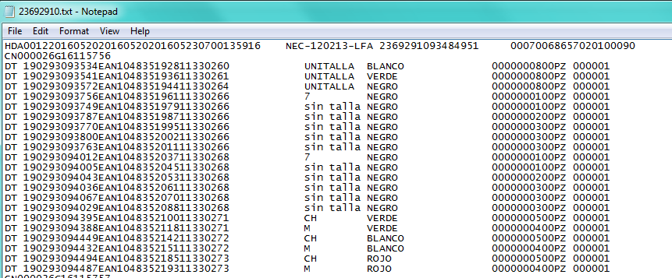
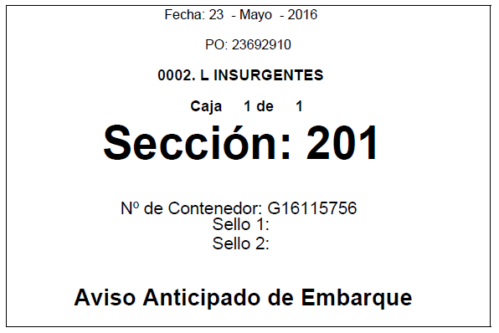
5. Create the TXT file where is the information that capture on the RFID TAG, if some ajustments were need to .INF file.
Delivery Date
Sales Order
RFID TAG (CONTREINER)
REMISION
5. Upload the TXT file to website and create an appointment to CEDIS and create an advantage advertising of the delivery with the follow information : delivery, PO, Store, Conteiner.

