Slide 1
CUSTOMER ELECTRONIC PRODUCT
CATALOG.
2015-02-26.

Slide 2
What we are trying to accomplish
Synchronize product data and images with our customers
Reduce errors in order flow
Increased data integrity
Increase customer’s order throughput
Make New Era easier to do business with

Slide 3
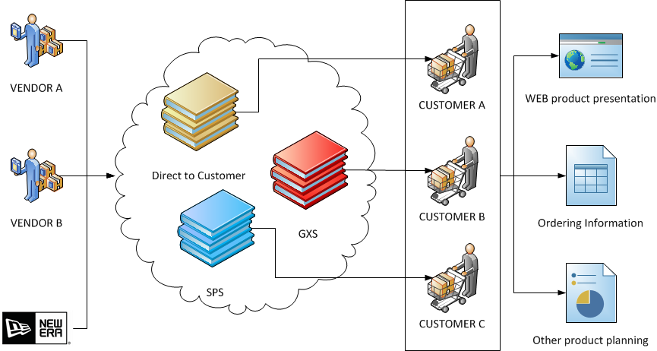
WHY DO CUSTOMERS WANT THIS?

Slide 4
WHY DO CUSTOMERS WANT THIS?
Electronic Catalogs with Multiple Product Characteristics

Slide 5
WHY DO CUSTOMERS WANT THIS?
Electronic Catalogs with Multiple Product Characteristics

Slide 6
WHY DO CUSTOMERS WANT THIS?
Electronic Catalogs with Multiple Product Characteristics

Slide 7
WHAT ATTRIBUTES DO WE NEED TO PROVIDE?
CATALOG | GTIN TYPE | CONSUMER ITEM HEIGHT
SELECTION CODE | PRODUCT | CONSUMER ITEM LENGTH
SELECTION CODE DESCRIPTION | UNIT OF MEASURE | CONSUMER ITEM WIDTH
MINIMUM ORDER QUANTITY | RETURN INSTRUCTIONS | PRODUCT COLOR CODE (PMS)
SEASONAL AVAILABILITY | POINT OF SHIPPING ORIGIN | PRODUCT COLOR DESCRIPTION (PMS)
MADE TO ORDER | RETURN CODE | CONSUMER ITEM NET WEIGHT
RE-ORDERABLE | DROP SHIP | PRODUCT COLOR CODE (NRF)
BRAND / TRADE NAME | LEAD TIME | HEADWEAR FIT
DATE - BOOKING | LEAD TIME CODE | HEADWEAR BILL TYPE
DATE - DISCONTINUE | HARMONIZED TARIFF SCHEDULE CODE | HEADWEAR CROWN
DATE - EFFECTIVE PRICE | MEDIA COMPRESSION QUALITY | PRODUCT SIZE CODE (NRF)
DATE - FIRST SHIP DATE | MEDIA DESCRIPTION | CONSUMER PACKAGE GROSS WEIGHT
PRICE - LIST | MEDIA FILE NAME | CONSUMER PACKAGE HEIGHT
PRICE - MSRP | MEDIA FILE SIZE | CONSUMER PACKAGE HEIGHT UOM
PRODUCT DESCRIPTION | MEDIA FORMAT | CONSUMER PACKAGE LENGTH
PRODUCT EXTENDED DESCRIPTION | MEDIA IMAGE HEIGHT | CONSUMER PACKAGE LENGTH UOM
PRODUCT SIZE CODE | MEDIA IMAGE WIDTH | CONSUMER PACKAGE WIDTH UOM
PRODUCT SIZE DESCRIPTION | MEDIA NAME | GENDER
PRODUCT TYPE | MEDIA ORIENTATION | PRODUCT FABRIC CODE
TEAM | MEDIA PIXEL DENSITY | PRODUCT FABRIC DESCRIPTION
PRICE - PURCHASE | MEDIA THUMBNAIL IMAGE | VENDOR COLLECTION NAME
PRICE - TAX / VAT | MEDIA URL | COUNTRY OF ORIGIN
GTIN
SEEMS DAUNTING!

Slide 8
WHAT ATTRIBUTES DO WE NEED TO PROVIDE?
Great News!
CATALOG | GTIN TYPE | CONSUMER ITEM HEIGHT
SELECTION CODE | PRODUCT | CONSUMER ITEM LENGTH
SELECTION CODE DESCRIPTION | UNIT OF MEASURE | CONSUMER ITEM WIDTH
MINIMUM ORDER QUANTITY | RETURN INSTRUCTIONS | PRODUCT COLOR CODE (PMS)
SEASONAL AVAILABILITY | POINT OF SHIPPING ORIGIN | PRODUCT COLOR DESCRIPTION (PMS)
MADE TO ORDER | RETURN CODE | CONSUMER ITEM NET WEIGHT
RE-ORDERABLE | DROP SHIP | PRODUCT COLOR CODE (NRF)
BRAND / TRADE NAME | LEAD TIME | HEADWEAR FIT
DATE - BOOKING | LEAD TIME CODE | HEADWEAR BILL TYPE
DATE - DISCONTINUE | HARMONIZED TARIFF SCHEDULE CODE | HEADWEAR CROWN
DATE - EFFECTIVE PRICE | MEDIA COMPRESSION QUALITY | PRODUCT SIZE CODE (NRF)
DATE - FIRST SHIP DATE | MEDIA DESCRIPTION | CONSUMER PACKAGE GROSS WEIGHT
PRICE - LIST | MEDIA FILE NAME | CONSUMER PACKAGE HEIGHT
PRICE - MSRP | MEDIA FILE SIZE | CONSUMER PACKAGE HEIGHT UOM
PRODUCT DESCRIPTION | MEDIA FORMAT | CONSUMER PACKAGE LENGTH
PRODUCT EXTENDED DESCRIPTION | MEDIA IMAGE HEIGHT | CONSUMER PACKAGE LENGTH UOM
PRODUCT SIZE CODE | MEDIA IMAGE WIDTH | CONSUMER PACKAGE WIDTH UOM
PRODUCT SIZE DESCRIPTION | MEDIA NAME | GENDER
PRODUCT TYPE | MEDIA ORIENTATION | PRODUCT FABRIC CODE
TEAM | MEDIA PIXEL DENSITY | PRODUCT FABRIC DESCRIPTION
PRICE - PURCHASE | MEDIA THUMBNAIL IMAGE | VENDOR COLLECTION NAME
PRICE - TAX / VAT | MEDIA URL | COUNTRY OF ORIGIN
GTIN

Slide 9
WHAT ATTRIBUTES DO WE NEED TO PROVIDE?
We have 95% of this data already!
CATALOG | GTIN TYPE | CONSUMER ITEM HEIGHT
SELECTION CODE | PRODUCT | CONSUMER ITEM LENGTH
SELECTION CODE DESCRIPTION | UNIT OF MEASURE | CONSUMER ITEM WIDTH
MINIMUM ORDER QUANTITY | RETURN INSTRUCTIONS | PRODUCT COLOR CODE (PMS)
SEASONAL AVAILABILITY | POINT OF SHIPPING ORIGIN | PRODUCT COLOR DESCRIPTION (PMS)
MADE TO ORDER | RETURN CODE | CONSUMER ITEM NET WEIGHT
RE-ORDERABLE | DROP SHIP | PRODUCT COLOR CODE (NRF)
BRAND / TRADE NAME | LEAD TIME | HEADWEAR FIT
DATE - BOOKING | LEAD TIME CODE | HEADWEAR BILL TYPE
DATE - DISCONTINUE | HARMONIZED TARIFF SCHEDULE CODE | HEADWEAR CROWN
DATE - EFFECTIVE PRICE | MEDIA COMPRESSION QUALITY | PRODUCT SIZE CODE (NRF)
DATE - FIRST SHIP DATE | MEDIA DESCRIPTION | CONSUMER PACKAGE GROSS WEIGHT
PRICE - LIST | MEDIA FILE NAME | CONSUMER PACKAGE HEIGHT
PRICE - MSRP | MEDIA FILE SIZE | CONSUMER PACKAGE HEIGHT UOM
PRODUCT DESCRIPTION | MEDIA FORMAT | CONSUMER PACKAGE LENGTH
PRODUCT EXTENDED DESCRIPTION | MEDIA IMAGE HEIGHT | CONSUMER PACKAGE LENGTH UOM
PRODUCT SIZE CODE | MEDIA IMAGE WIDTH | CONSUMER PACKAGE WIDTH UOM
PRODUCT SIZE DESCRIPTION | MEDIA NAME | GENDER
PRODUCT TYPE | MEDIA ORIENTATION | PRODUCT FABRIC CODE
TEAM | MEDIA PIXEL DENSITY | PRODUCT FABRIC DESCRIPTION
PRICE - PURCHASE | MEDIA THUMBNAIL IMAGE | VENDOR COLLECTION NAME
PRICE - TAX / VAT | MEDIA URL | COUNTRY OF ORIGIN
GTIN

Slide 10
CATEGORY - DATA
MINIMUM ORDER QUANTITY | DATE - EFFECTIVE PRICE
SEASONAL AVAILABILITY | DATE - FIRST SHIP DATE
MADE TO ORDER | PRICE – LIST
RE-ORDERABLE | PRICE – MSRP
BRAND / TRADE NAME | PRODUCT DESCRIPTION
DATE – BOOKING | PRODUCT EXTENDED DESCRIPTION
DATE – DISCONTINUE | PRODUCT SIZE CODE
PRODUCT SIZE DESCRIPTION | PRODUCT TYPE
TEAM
Most fields (Green) require no additional work
Yellow fields will require some work
Can Minimum Order Quantity default to 1?
Conversation is required for the Product Extended Description

Slide 11
ENGINEERING - data
No New Data Requirements
GTIN / EAN / UPC
GTIN TYPE
PRODUCT (MATERIAL ID)
UNIT OF MEASURE

Slide 12
Logistics - DATA
RETURN INSTRUCTIONS*
RETURN CODE*
POINT OF SHIPPING ORIGIN
HARMONIZED TARIFF SCHEDULE CODE
[*] Return instructions will be a one time setup and a default going forward

Slide 13
Marketing - Data
No New Data Requirements
MEDIA COMPRESSION QUALITY | MEDIA IMAGE WIDTH
MEDIA DESCRIPTION | MEDIA NAME
MEDIA FILE NAME | MEDIA ORIENTATION
MEDIA FILE SIZE | MEDIA PIXEL DENSITY
MEDIA FORMAT | MEDIA THUMBNAIL IMAGE
MEDIA IMAGE HEIGHT | MEDIA URL

Slide 14
Merchandising - Data
CONSUMER ITEM HEIGHT¹ | HEADWEAR FIT¹ | CONSUMER PACKAGE LENGTH
CONSUMER ITEM LENGTH¹ | HEADWEAR BILL TYPE¹ | CONSUMER PACKAGE LENGTH UOM
CONSUMER ITEM WIDTH¹ | HEADWEAR CROWN¹ | CONSUMER PACKAGE WIDTH UOM
CONSUMER ITEM NET WEIGHT¹ | PRODUCT SIZE CODE (NRF)¹ | GENDER
PRODUCT COLOR DESCRIPTION (PMS) | CONSUMER PACKAGE GROSS WEIGHT | PRODUCT FABRIC CODE
PRODUCT COLOR CODE (PMS)² | CONSUMER PACKAGE HEIGHT | PRODUCT FABRIC DESCRIPTION
PRODUCT COLOR CODE (NRF)² | CONSUMER PACKAGE HEIGHT UOM | VENDOR COLLECTION NAME
[1] Will be derived by business rules associated with silhouettes
[2] Requires consistent data

Slide 15
Sourcing - data
No New Data Requirements
COUNTRY OF ORIGIN
DROP SHIP
LEAD TIME
LEAD TIME CODE

Slide 16
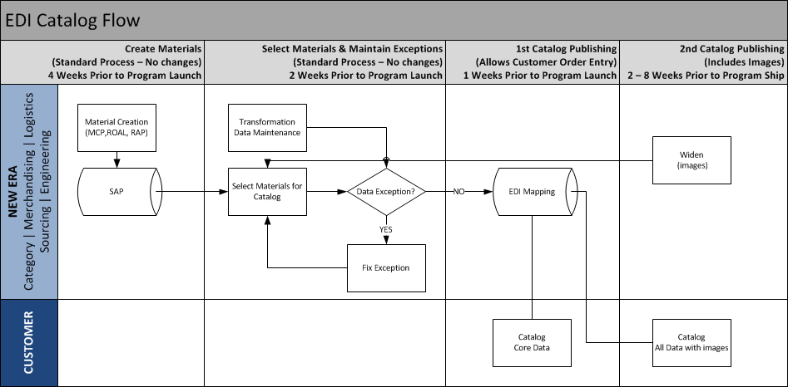
PROCESS flow

Slide 17
PROCESS flow

Slide 18
PROCESS flow

Slide 19
PROCESS flow
Could present challenges meeting timeline

Slide 20
Project TIMELINE
BUILD (2/16 – 3/27)
  SAP and Program development
  Identify Process owners
  Testing
  Catalog clean-up
  Education
FINAL PREP (3/30 - 4/3)
  Master data entry
GO-LIVE & SUPPORT (4/6)
  Lids: first retailer

Slide 21
NEXT STEPS
Identify process owners
  Filip to schedule follow-up next week
Discussions on master data maintenance
  Filip to schedule individually or key groups next week

Slide 22
WALKTHROUGH.
Creating Materials in the Catalog
Materials will be created in SAP through either MCP, Spreadsheet, ROAL or RAP
Business users will maintain transformation master data at MDP.NEWERACAP.COM (required if new silhouettes are created)
Using SAP the business will select either the Season/Collection or Material Range to be sent to the catalog.
The product data will be put into a staging location and flag materials in SAP as “Include in Catalog”. This staging area also includes silhouette dependent transformation data, previously maintained by the business.
An EDI process will run on a set schedule to pull data from our staging location and send the product data to the catalog.
Material Images
On a set schedule the staging database will also check to see if images are available that have been sent to the catalog. If images are available, they are added as changes and sent to the catalog. As long as the materials have previously be sent using SAP then no other action is required here other than the agreed process of image maintenance in the WIDEN system.

Slide 23
WALKTHROUGH.
Exception Handling
A BI report will run to show all materials with incomplete data that will need to be maintained.
A secondary report to show all materials no maintained images will also be available.
If there are errors, the business must fix the data and select range of materials required using the SAP transaction Zxxx
Material Updates / Changes / Deletions
On a set schedule, SAP will check for any “Include in Catalog” materials that have changed. Those updates will be sent to the catalog.
Materials will be deleted from the catalog if the “Include at Catalog” is un-checked or the material is flagged for deletion
Materials will be updated in the catalog if core information changes such as description, product hierarchy, season / collection etc.

