Slide 1
GLOBAL SUPPLY CHAIN INITIATIVE (GSCI)
DOWNLOAD STATUS of SUPPLY CHAIN ORDERS (DSSCO)
GSCI and DSSCO Functional Overview
Baiwa Zhang

Slide 2
GLOBAL SUPPLY CHAIN INITIATIVE (GSCI)
DOWNLOAD STATUS of SUPPLY CHAIN ORDERS (DSSCO)
Allows tighter integration between New Era and our Suppliers in native language (Chinese)
Goals
  Increase visibility
  Tighten controls over transactions such as printing labels.
  Dropship EDI accounts

Slide 3
GLOBAL SUPPLY CHAIN INITIATIVE (GSCI)
DOWNLOAD STATUS of SUPPLY CHAIN ORDERS (DSSCO)
GSCI
  SAP access
    Allows the supplier to print labels for direct shipments to customers
    Access SAP in Chinese
  DSSCO application
    Allows the supplier to download Purchase Order Information
    Allows the supplier to give status updates on Purchase Orders (Acknowledged. Cut, Complete)
    Provides Specification Reports
    Provides Packing Instructions
    To help support Logistics booking and shipping processes can be completed for approved shipping vendors
GSCI Lite
  DSSCO application only

Slide 4
GLOBAL SUPPLY CHAIN INITIATIVE (GSCI)
DOWNLOAD STATUS of SUPPLY CHAIN ORDERS (DSSCO)
GSCI vendors
  MAINLAND
  ASI
  EVERBRITE
  JACKBEANIE
  MEI FAI
  BCMART
GSCI partners
  UPS (active)
  FedEx (working process)
  DHL (TBD)
  RATONE
  QF
  TTD
  Techniprint
  Master Garments
  Charm Asia
  Sigma Clothing
  Kostroma Lomisted
  Citextiles/Texcauca
  5 star
  H&S
  Ningbo Longfei
  SHK

Slide 5


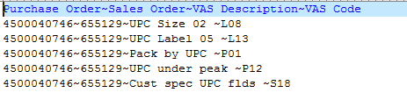
DOWNLOAD STATUS of SUPPLY CHAIN ORDERS (DSSCO)
Download
Save order File
Save VAS File

Slide 6
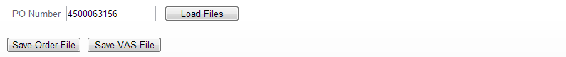
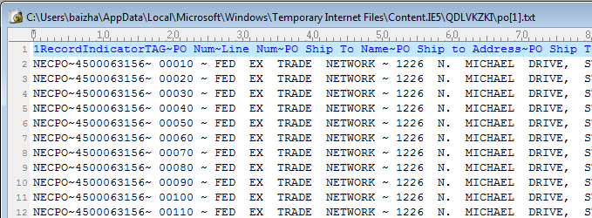
PO related information are available for download in DSSCO up to 90 days after posting date

Slide 7
DOWNLOAD STATUS of SUPPLY CHAIN ORDERS (DSSCO)
Report Status
  Acknowledge – ZE
  PO confirm – ZB
  Cut – ZJ
  Embroidery – ZS
  Sewing – ZN
  Line complete – ZO
  PO complete – ZT

Slide 8
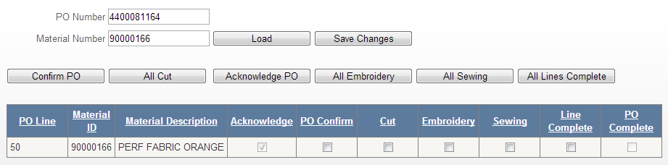
DOWNLOAD STATUS of SUPPLY CHAIN ORDERS (DSSCO)
Report Status
Optional search filter – material number has been added in Report Status tab. Vendors can now enter PO and material number and only confirming those PO lines with those materials.

Slide 9


DOWNLOAD STATUS of SUPPLY CHAIN ORDERS (DSSCO)
Upload
Load CSV file in the following format to mass-update a PO status
  One row for each PO line
  One ‘X’ for each status (acknowledge, cut and line complete)

Slide 10
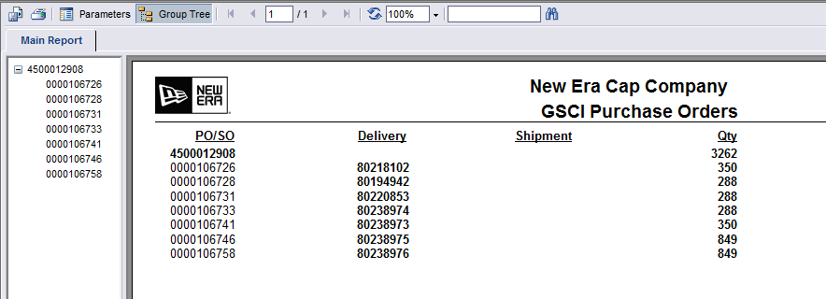
DOWNLOAD STATUS of SUPPLY CHAIN ORDERS (DSSCO)
PO Report

Slide 11
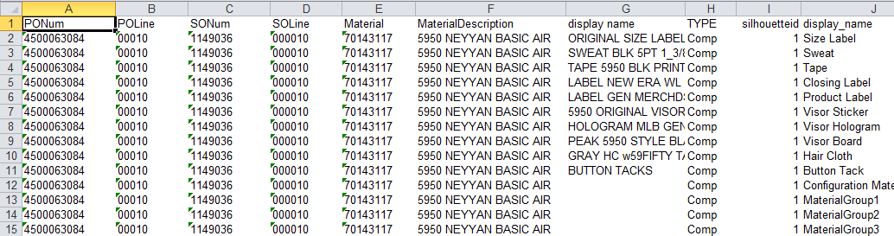
DOWNLOAD STATUS of SUPPLY CHAIN ORDERS (DSSCO)
SPEC Report
View Components

Slide 12
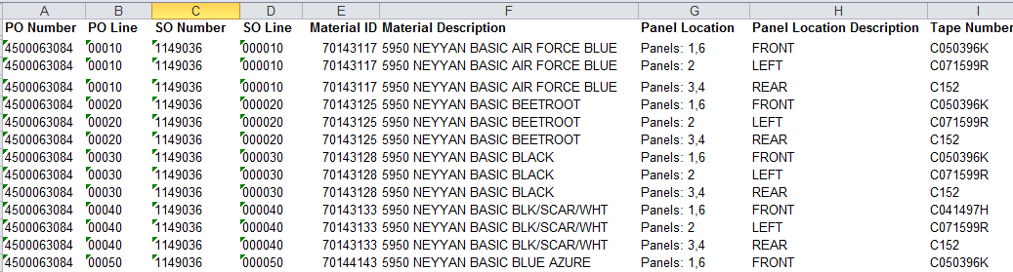
DOWNLOAD STATUS of SUPPLY CHAIN ORDERS (DSSCO)
SPEC Report
View Embroideries

Slide 13

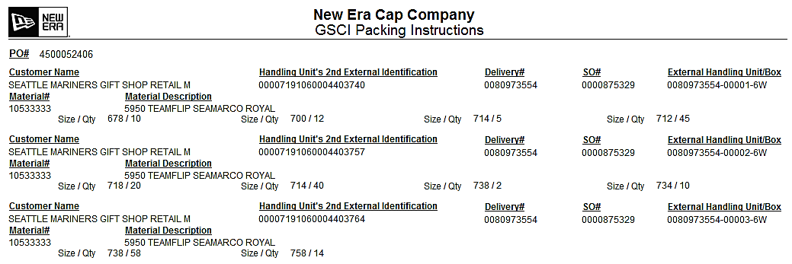
DOWNLOAD STATUS of SUPPLY CHAIN ORDERS (DSSCO)
Packing
View Data – Packing instructions from SAP after deliveries are created

Slide 14
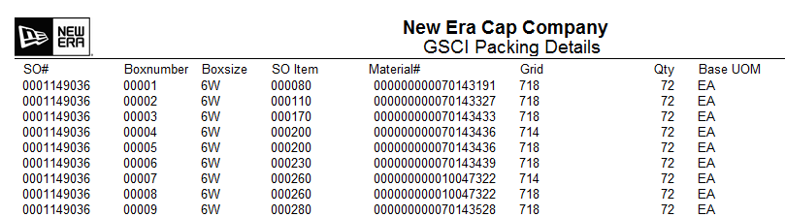
DOWNLOAD STATUS of SUPPLY CHAIN ORDERS (DSSCO)
Packing Details: simulated packing instruction before deliveries are actually created

Slide 15
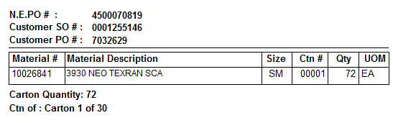
Provide for labeling of generic corrugated boxes
Instead of sending label information to corrugated box company to spray the box, then wait for the box to be sent back and then ship, vendors now can print labels from DSSCO.

Slide 16
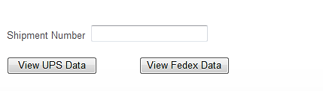
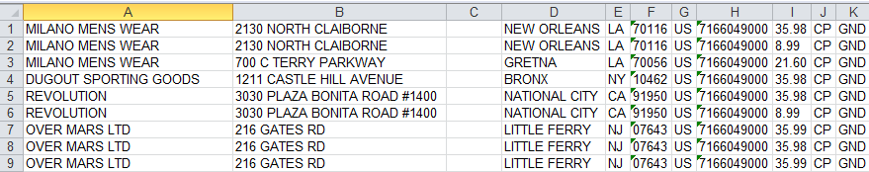
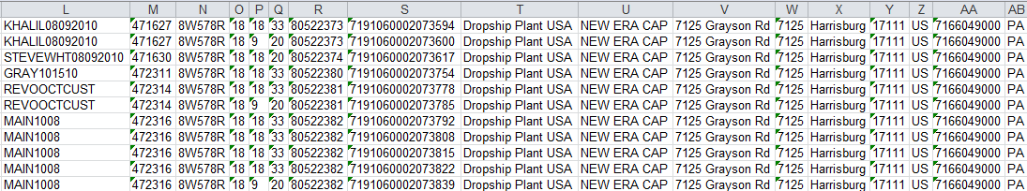
DOWNLOAD STATUS of SUPPLY CHAIN ORDERS (DSSCO)
Shipment tab – hidden https://apps.neweracap.com/dssco/shipment.aspx

Slide 17
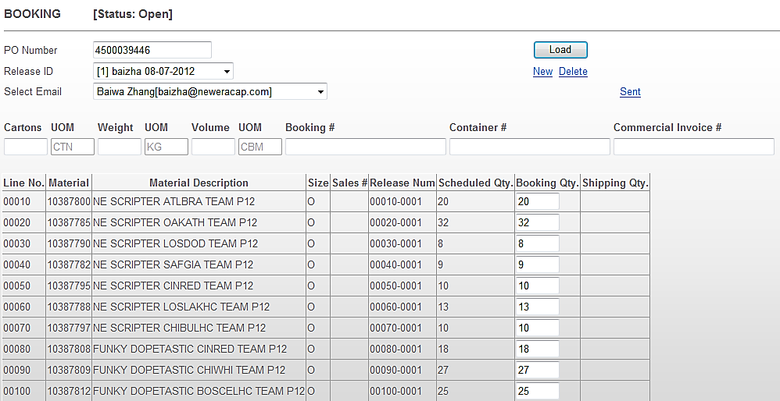
DOWNLOAD STATUS of SUPPLY CHAIN ORDERS (DSSCO)
Booking
Allow vendors to send booking information to freight forwarders
  1. Create new booking

Slide 18
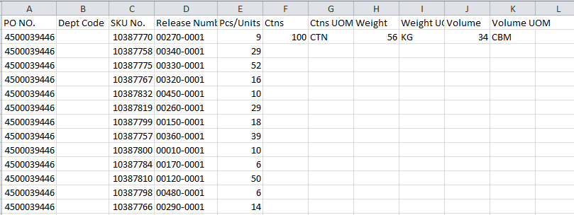
DOWNLOAD STATUS of SUPPLY CHAIN ORDERS (DSSCO)
Booking
Allow vendors to send booking information to freight forwarders
  2. Send new booking through email

Slide 19
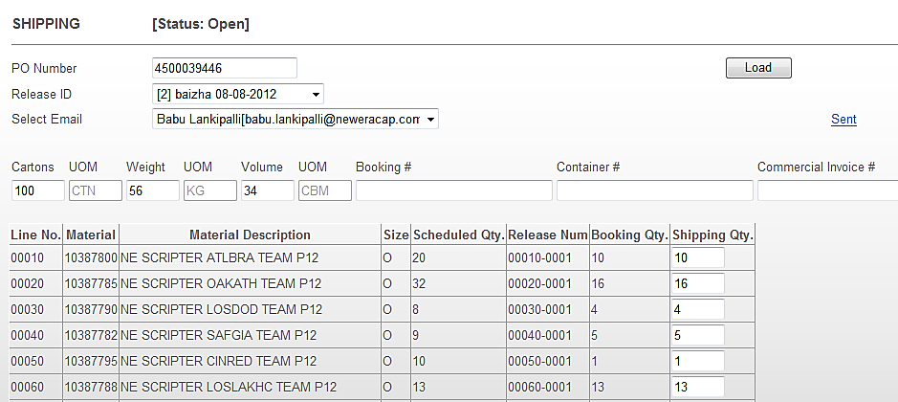
DOWNLOAD STATUS of SUPPLY CHAIN ORDERS (DSSCO)
Shipping (cannot only be performed after booking)
Allow vendors to send shipping information to freight forwarders
  1. Load shipping by PO number

Slide 20
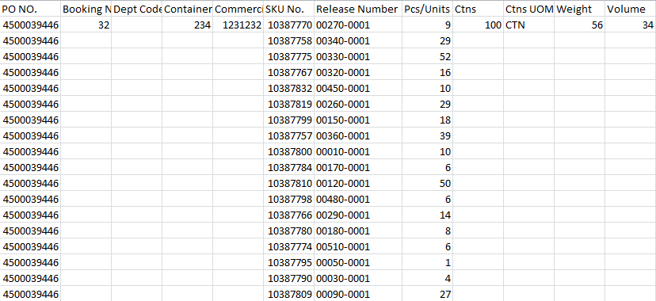
DOWNLOAD STATUS of SUPPLY CHAIN ORDERS (DSSCO)
Shipping (cannot only be performed after booking)
Allow vendors to send shipping information to freight forwarders
  2. Send shipping information through email

Slide 21
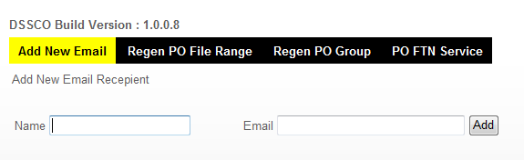
DOWNLOAD STATUS of SUPPLY CHAIN ORDERS (DSSCO)
Admin
Allows Logistics users to maintain freight forwarder email addresses

