Slide 1
Packing project.
October 2015.
Notes:
High level overview of the project at hand

Slide 2
goals.
Implement an updated headwear packing solution
  Pack all silhouettes
  Mix silhouettes if acceptable
  Customer-specific packing
Implement package tracking in SAP
Implement address validation in SAP

Slide 3
Headwear packing.
Program: /PWEAVER/AUTOPACK_HW
  Max Box Size
    Default 6*, can be overridden by customer VAS
  Pack by
    Default Mixed, can be overridden by customer VAS
  Box Series
    Based on Pack by, and data in /PWEAVER/CARTYPE
  Alternate Unit of Measure
    Based on data in /PWEAVER/CARTYPE

Slide 4
Headwear packing.
Key tables
  /PWEAVER/CARTYPE
  /PWEAVER/VASRULE
  /PWEAVER/VASRL
  /PWEAVER/SHMAS
  /PWEAVER/SHALT
  /PWEAVER/PKGRULE
  /PWEAVER/CASHMAS

Slide 5
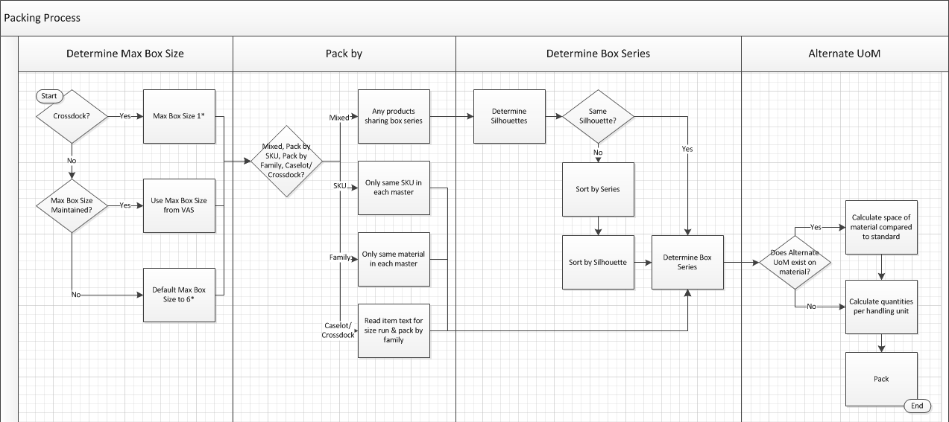
Headwear packing.
Process Flow

Slide 6
Track & Trace.
Transaction: /PWEAVER/MANIFEST
  Delivery data
  Handling unit data
  Tracking number (with link to carrier portal)
  Current status from carrier (via API)
  Proof-of-Delivery (POD) information (via API)

Slide 7
Track & Trace.
Tables:
  /PWEAVER/MANFEST
  /PWEAVER/SHIPURL
  /PWEAVER/CCONFIG
Configuration
  /PWEAVER/SPRO
    Maintain PW API’s for Carrier Communication
    Maintain Communication URL’s for Web Service Carriers
    Maintain URL’s for Carrier Tracking Websites
  /PWEAVER/ETT_STATUS

Slide 8
Track & Trace.
Programs:
  /PWEAVER/ETT_POD
  /PWEAVER/SAPLGETT
  /PWEAVER/ECS_POD
Function Modules:
  /PWEAVER/FEDEX_ETT
  /PWEAVER/UPS_ETT
  /PWEAVER/DHL_ETT

Slide 9
Address validation.
Validates address against standards from:
  UPS
  FedEx
  USPS
Triggers:
  Creation/change of Customer (XD01/XD02)
  Creation/change of Sales Order (VA01/VA02)

Slide 10

Questions.

