Slide 1
SUPPLIER NETWORK COLLABORATION
AT NEW ERA CAP COMPANY
August 6 2013

Slide 2
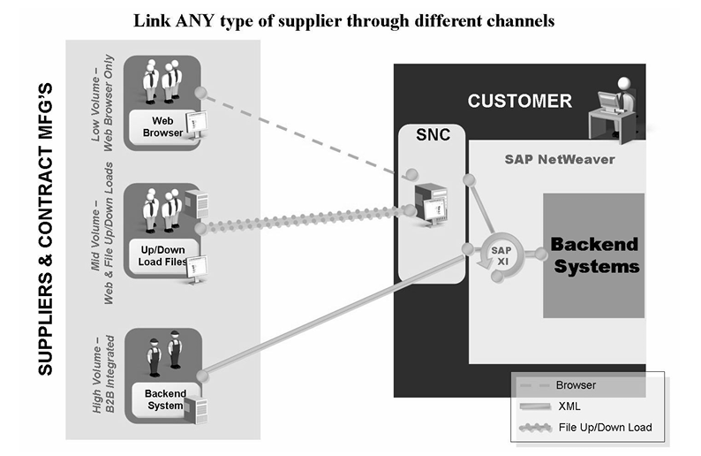
SNC – Collaboration Methods

Slide 3
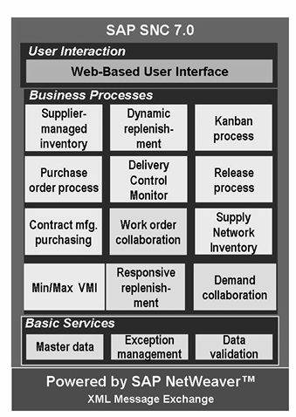
SNC – Functions and Features

Slide 4
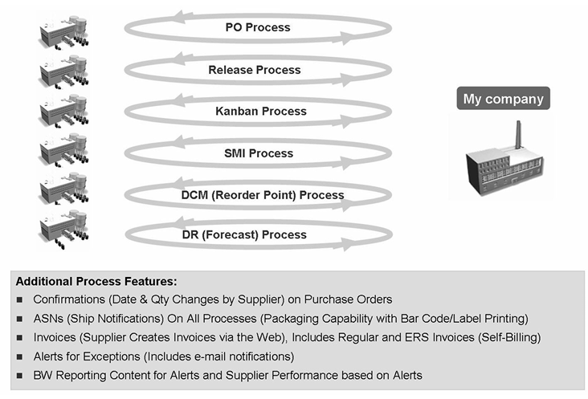
SNC – Finished/Raw Material/Component Supply Processes

Slide 5
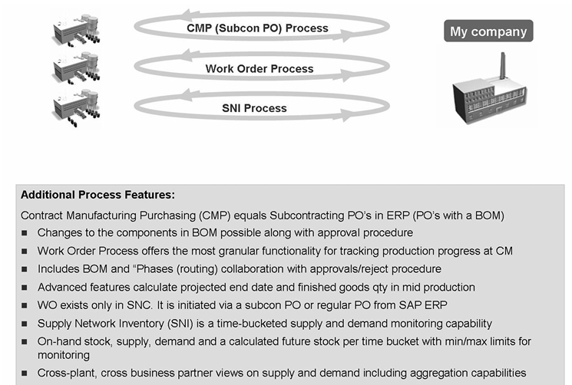
Contract Manufacturing Supply Business Processes

Slide 6
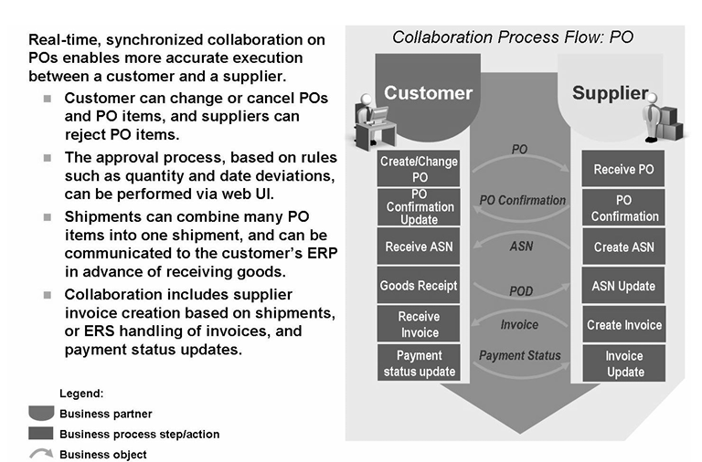
Purchase Order Process Overview

Slide 7
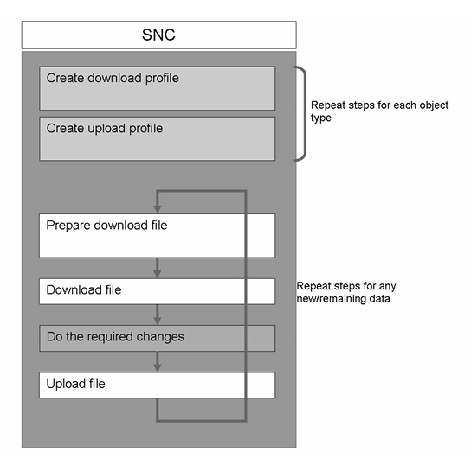
File Transfer
Provides solution for mid-volume supplier to import/export SNC data that they would otherwise see on the SNC Web screen
Enables external suppliers to download data - e.g. list of New Purchase Orders
Enables suppliers to edit/add downloaded data locally and upload back to SNC - e.g. PO confirmations

Slide 8
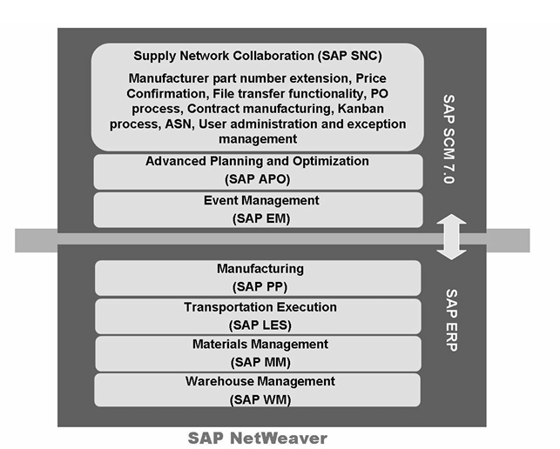
SCM 7.0 Landscape
SNC is included in SAP SCM 7.0 in one system instance. However, SNC can also be run separately or together with either APO or SAP EM. The 2 deployment models are called "server" and "standalone.

Slide 9
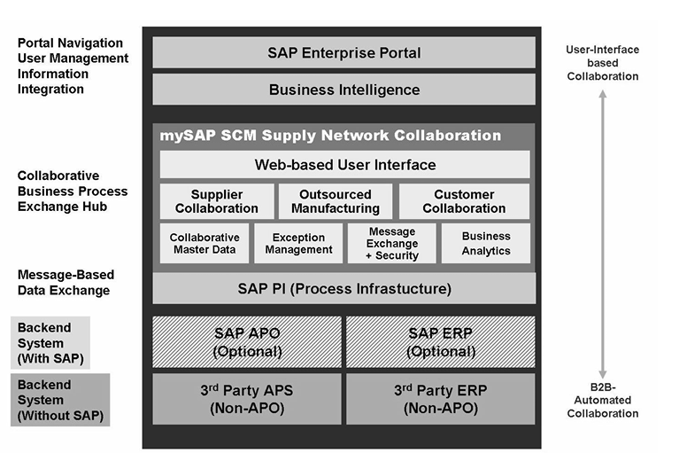
SNC is based on NetWeaver Technology stack
Function | Component
User Interface | Web based (ABAP version of Web DynPro)
App Server | SAP ABAP on NetWeaver App Server
Integration | NetWeaver PI for message integration using XML
ERP | Integrates out of the box with content (mappings) between ECC and NetWeaver PI (Idocs and SNC XMLs)
: :
:
:
(Optional)

Slide 10
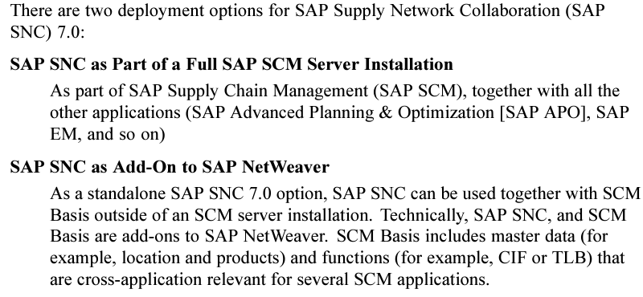
SNC – Deployment Options

Slide 11
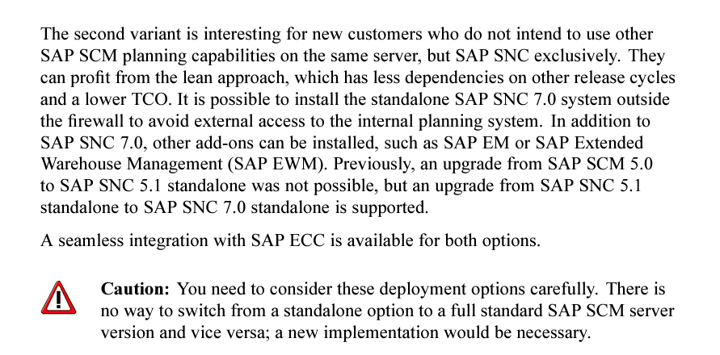
SNC – Deployment Options (continued)

Slide 12
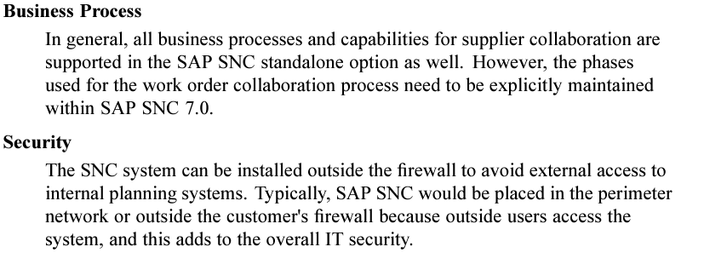
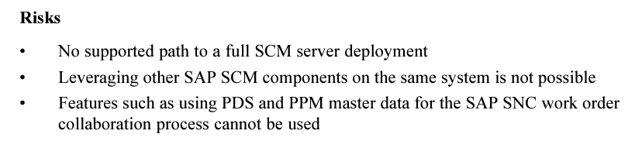
SNC – Stand Alone Deployment

Slide 13
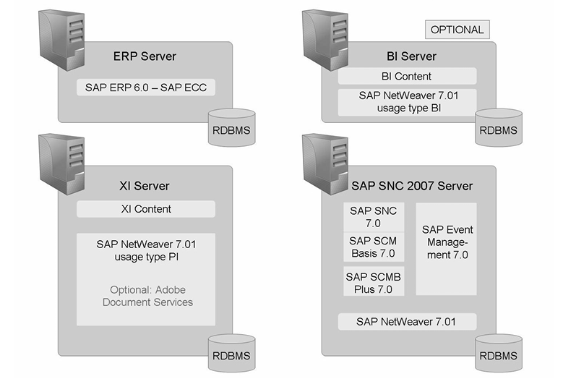
System Landscape with Event Management

Slide 14
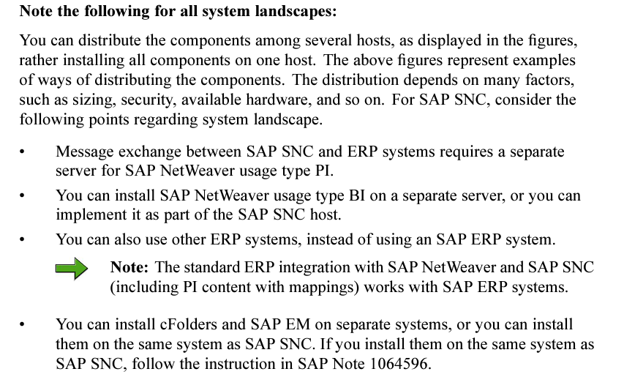
System Landscape with Event Management

Slide 15
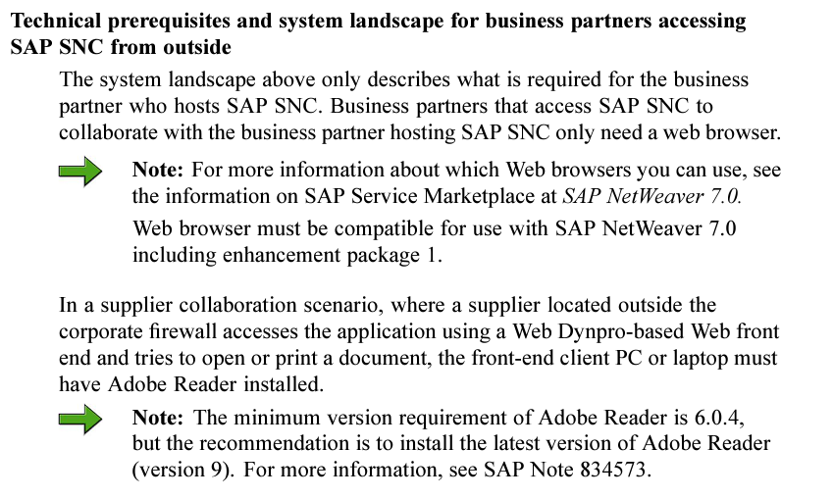
System Landscape

Slide 16
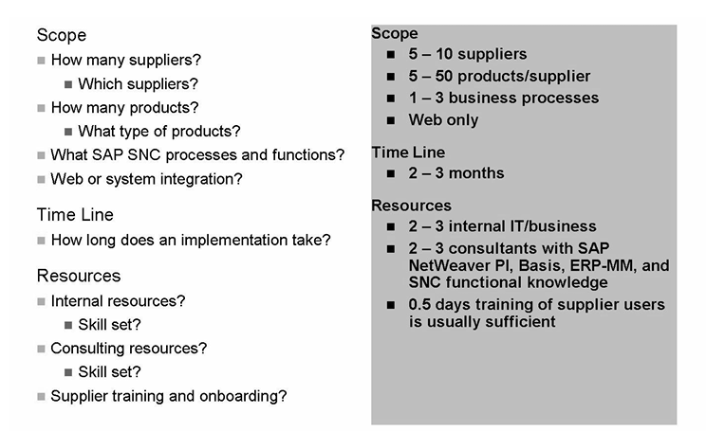
Project Planning
We need to add time for AFS handling and related NetWeaver XI development

