Slide 1
PAYEE Positive pay

Slide 2
topics.
Overview
Process Flow
Technical Walkthrough
  Reports
  Interfaces
  Conversions
  Enhancements
  Forms
  Workflow
Questions

Slide 3
Overview.
Objective
  Reduce Risks and prevent fraud
  Automate check voiding process. Increased control and visibility of void checks
  Key Resources
  - Treasury, Accounts Payable, IT

Slide 4
Overview.
  Scope
  Payee Positive Pay
  Daily check data file generation and integration with M&T acknowledgement upon receipt
  Void check data file generation and integration with M&T
  Current checks printout format update
  Check print out to include wording for expiration date 180 days
  Report of uncashed expired checks for Finance Team to review
  M&T check status Reconciliation Report (monthly)
  Vendor master data clean up – No special character
  AP process update
  Inbound file from M&T to update cashed checks

Slide 5
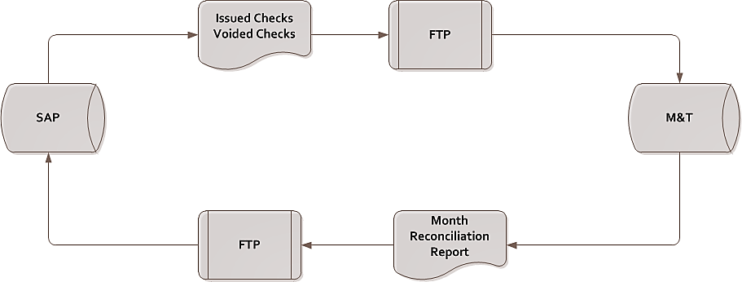
Process flow.

Slide 6
reports.
SAP/ Crystal report to display uncashed expired checks for Finance Team to review

Slide 7
interfaces.
File Transmission Tool
  MFT job for file transfer
  PGP encryption
  FTP network protocol

Slide 8
conversions.
N/A

Slide 9
enhancements.
N/A

Slide 10
forms.
Current check form
  Update amount format
  Add 180-day expiration date wording

Slide 11
workflow.
N/A

Slide 12

Questions.

